Slide 1


Jane Mburu
October 21, 2023

Slide 2

Outline
Executive Summary
Introduction
Methodology
Results
Conclusion
Appendix

Slide 3
Executive Summary
Summary of Methodologies:
Data Collection
Data wrangling and formatting
Exploratory Data Analysis (EDA) with Visualization
EDA with SQL
Building an Interactive map with Folium
Building a Dashboard with Plotly.
Predictive Analysis
Summary of all Results
EDA Results
Interactive Analytics
Predictive Analysis (Classification)

Slide 4
Introduction
The purpose of this project is to predict if Falcon 9 first stage will land successfully. SpaceX advertises Falcon 9 rocket launches on its website with a cost of 62 million dollars; other providers cost upward of 165 million dollars each, much of the savings is because SpaceX can reuse the first stage. As such, if we can determine if the first stage will land, then we can determine the cost of a launch. This information is critical as it can be used if an alternate company wants to bid against SpaceX for a rocket launch.
The overarching question that this project is trying to answer is, for a given set of features about Falcon 9 launch including its payload mass, orbit type, launch site etc will the first stage of the rocket land successfully?

Slide 5

Section 1

Slide 6
Methodology
Executive Summary
Data collection methodology:
SpaceX Rest Api
Web Scraping from Wikipedia
Perform data wrangling
One Hot Encoding data fields for Machine Learning and data cleaning of null values and null values
Perform exploratory data analysis (EDA) using visualization and SQL
Perform interactive visual analytics using Folium and Plotly Dash
Perform predictive analysis using classification models
LR, KNN, DT, SVM were built and evaluated for the best classifier.

Slide 7
Data Collection
The following data sets were collected:
SpaceX API
WebScraping
The link to SpaceX API:
Applied-Data-Science-Capstone-Project/jupyter-labs-spacex-data-collection-api.ipynb at main · JMburu23/Applied-Data-Science-Capstone-Project (github.com)
The link to WebScraping:
Applied-Data-Science-Capstone-Project/jupyter-labs-webscraping.ipynb at main · JMburu23/Applied-Data-Science-Capstone-Project (github.com)

Slide 8
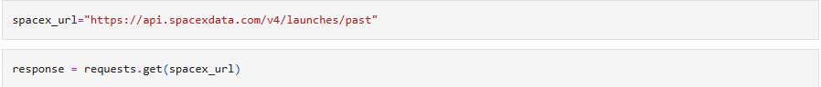
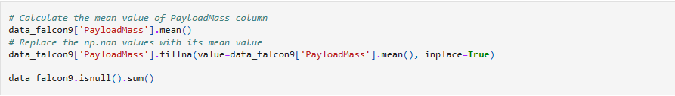
Data Collection – SpaceX API
Present your data collection with SpaceX REST calls using key phrases and flowcharts
Link to the notebook: (Applied-Data-Science-Capstone-Project/jupyter-labs-spacex-data-collection-api.ipynb at main · JMburu23/Applied-Data-Science-Capstone-Project (github.com)
1.Get request for rocket launch data using API
2. Use Json_normalize method to convert json results to dataframe
3. Perform data cleaning and filling in missing values

Slide 9
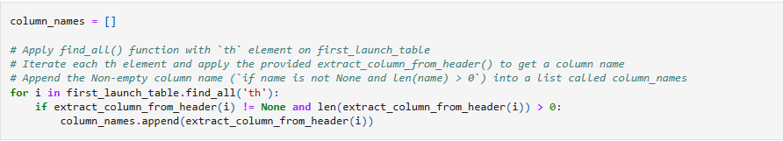
Data Collection - Scraping
We applied webscraping to webscrap Falcon 9 launch records with Beautiful Soup.
We parsed the table and converted it into a pandas dataframe.
The link to the notebook is:Applied-Data-Science-Capstone-Project/jupyter-labs-webscraping.ipynb at main · JMburu23/Applied-Data-Science-Capstone-Project (github.com)
1.Apply HTTP GET method to request the Falcon9 Launch HTML page, as an HTTP response
2. Create Beautiful Soup object from the HTML response
3. Extract column names from the HTML table header
4. Create a dataframe by parsing the launch HTML tables.
5. Export data to CSV

Slide 10
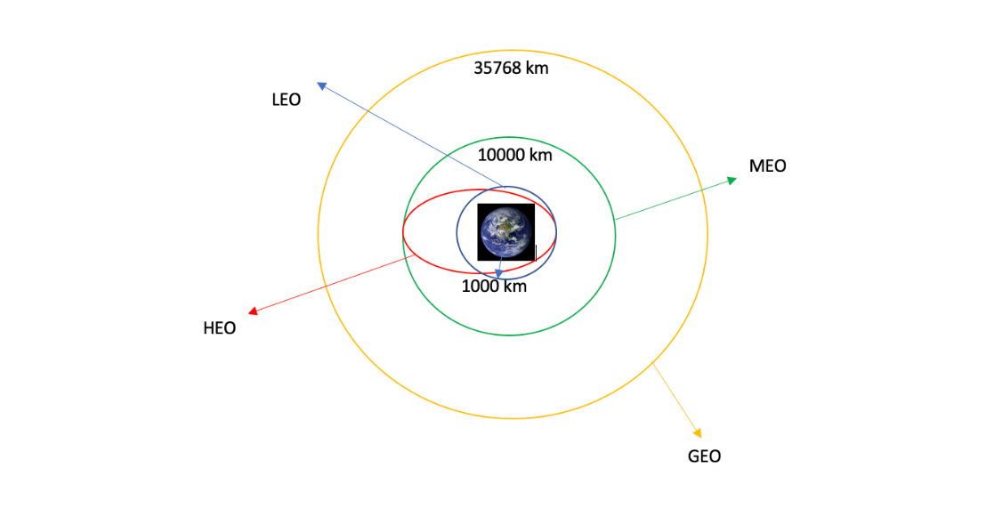
Data Wrangling
We performed exploratory data analysis and determined the training lables.
We then calculated the number of launches at each site, and the number of occurrence of each orbits.
After, we created the landing outcome label from outcome column and exported the results to csv.
The link to the notebook is:Applied-Data-Science-Capstone-Project/labs-jupyter-spacex-Data wrangling.ipynb at main · JMburu23/Applied-Data-Science-Capstone-Project (github.com)

Slide 11
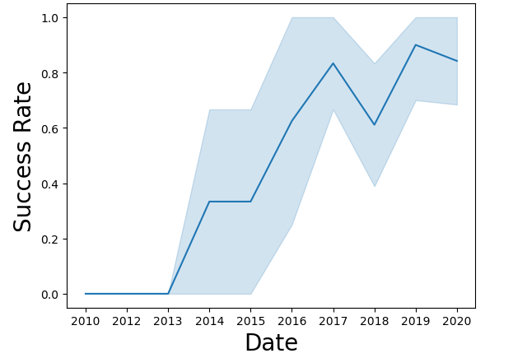
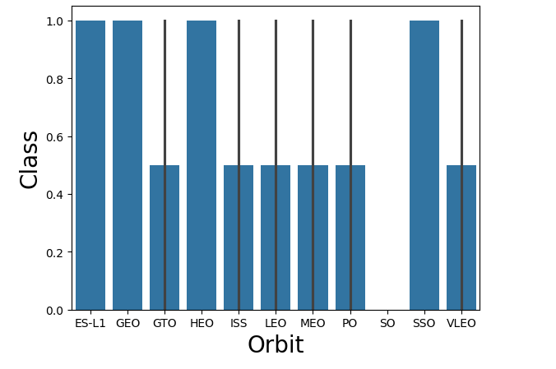
EDA with Data Visualization
We explored the data by visualizing the relationship between flight number and launch Site, payload and launch site, success rate of each orbit type, flight number and orbit type, the launch success yearly trend.
Plot of Launch success yearly trend
Plot of Success Rate by Class

Slide 12
EDA with SQL
We executed the following SQL queries to answer the project questions:
Names of unique launch sites in the space mission
Launch sites beginning with the string ‘CCA’
The total payload mass carried by boosters launched by NASA (CRS)
The average payload mass carried by booster version F9 v1.1
Total number of successful and failure mission outcomes
Failed landing outcomes in drone ship, their booster version and launch sites n
Link to the notebook is: Applied-Data-Science-Capstone-Project/jupyter-labs-eda-sql-coursera_sqllite.ipynb at main · JMburu23/Applied-Data-Science-Capstone-Project (github.com)

Slide 13
Build an Interactive Map with Folium
We marked all launch sites, and added map objects such as markers, circles, lines to mark the success or failure of launches for each site on the folium map.
We assigned the feature launch outcomes (failure or success) to class 0 and 1.
Using the color-labeled marker clusters, we identified which launch sites have relatively high success rate.
We calculated the distances between a launch site to its proximities to answer some project questions.
Link to the notebook: Applied-Data-Science-Capstone-Project/IBM-DS0321EN-SkillsNetwork_labs_module_3_lab_jupyter_launch_site_location.jupyterlite.ipynb at main · JMburu23/Applied-Data-Science-Capstone-Project (github.com)

Slide 14
Build a Dashboard with Plotly Dash
We built an interactive dashboard with Plotly dash
We plotted pie charts showing the total launches by a certain sites
We plotted scatter graph showing the relationship with Outcome and Payload Mass (Kg) for the different booster version
Link to the notebook: Applied-Data-Science-Capstone-Project/spacex_dash_app (1).py at main · JMburu23/Applied-Data-Science-Capstone-Project (github.com)

Slide 15
Predictive Analysis (Classification)
We loaded the data using numpy and pandas, transformed the data, split our data into training and testing.
We created different machine learning models and tuned different hyperparameters using GridSearchCV.
We calculated accuracy and used it as the metric for our model, improved the model using feature engineering and algorithm tuning.
We found the best performing classification model.
Link to the notebook: Applied-Data-Science-Capstone-Project/IBM-DS0321EN-SkillsNetwork_labs_module_4_SpaceX_Machine_Learning_Prediction_Part_5.jupyterlite.ipynb at main · JMburu23/Applied-Data-Science-Capstone-Project (github.com)

Slide 16
Results
Exploratory data analysis results
Interactive analytics demo in screenshots
Predictive analysis results

Slide 17

Section 2

Slide 18
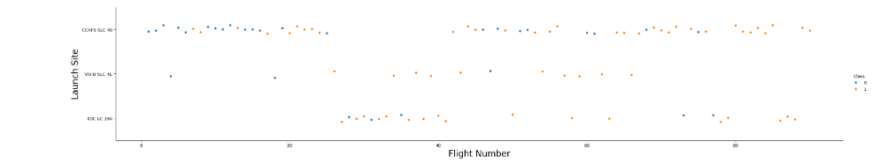
Flight Number vs. Launch Site
From the plot, we found that the success rate at a launch site increases with the increase in the flight number.

Slide 19
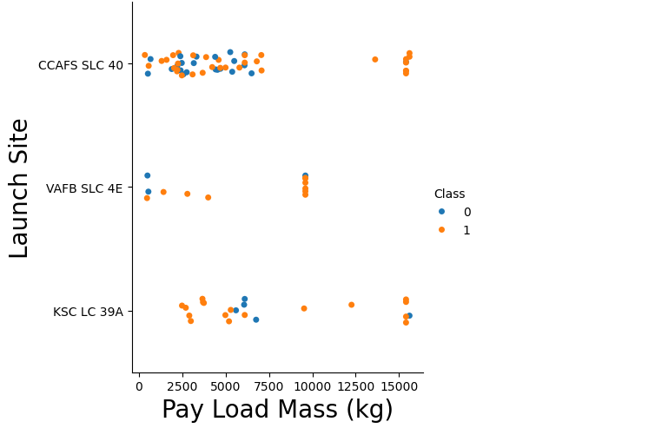
Payload vs. Launch Site
From the scatter plot, it is evident that increase in Pay Load Mass (kg) increases the launch site success rate of CCAFS SLC 40

Slide 20
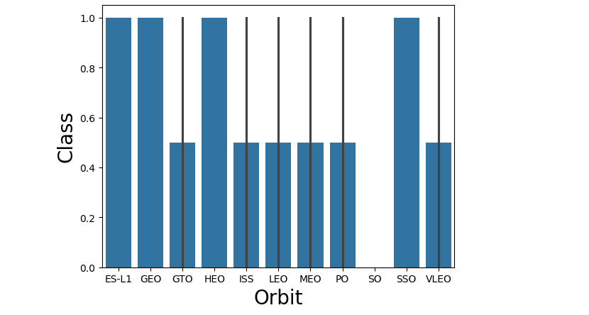
Success Rate vs. Orbit Type
From the bar chart, it is evident that orbit type ES-L1, GEO, HEO, SSO had the most success rate

Slide 21
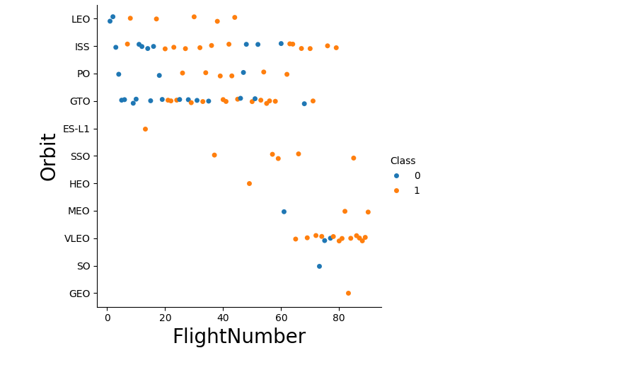
Flight Number vs. Orbit Type
In this scatter plot, we observe that the success rate of LEO orbit is related to the number of flights whereas there appears to be no relationship between flight number and GTO orbit.

Slide 22
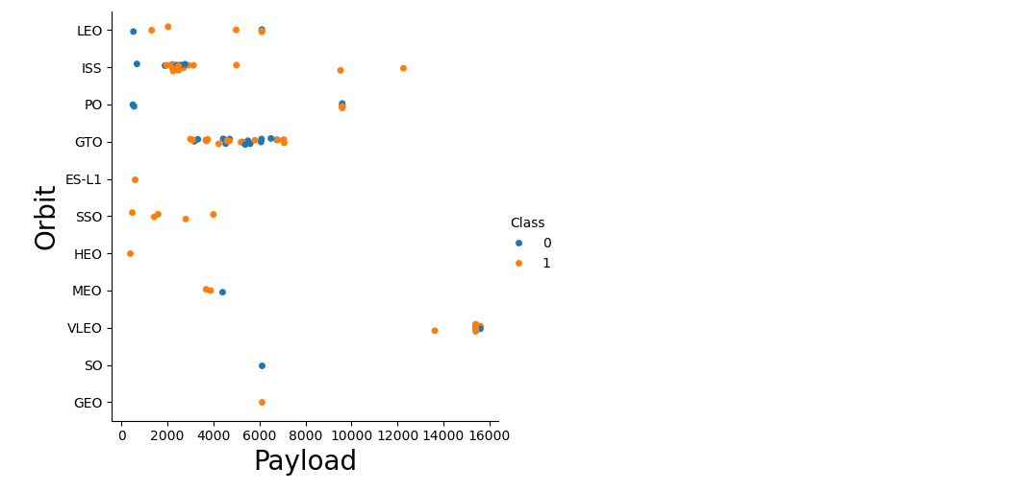
Payload vs. Orbit Type
From this scatter plot, we can observe that with heavy payloads, the successful landing are more for PO, LEO and ISS orbits, however, for GTO we cannot distinguish this.

Slide 23
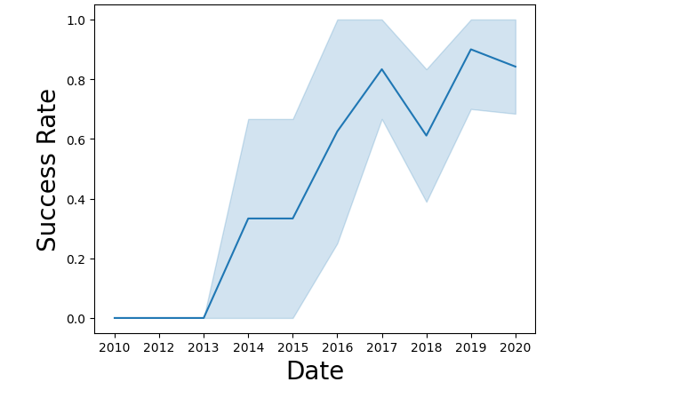
Launch Success Yearly Trend
From the plot, we can observe that success rate since 2013 kept on increasing till 2020

Slide 24
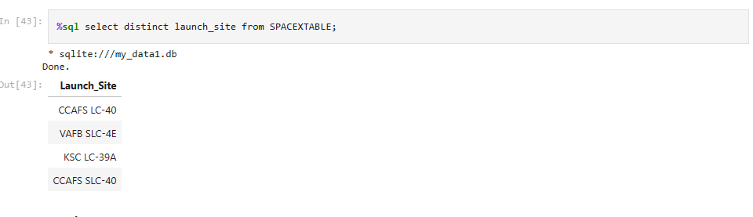
All Launch Site Names
We used the key word DISTINCT to show only unique launch sites from the SpaceX data.

Slide 25
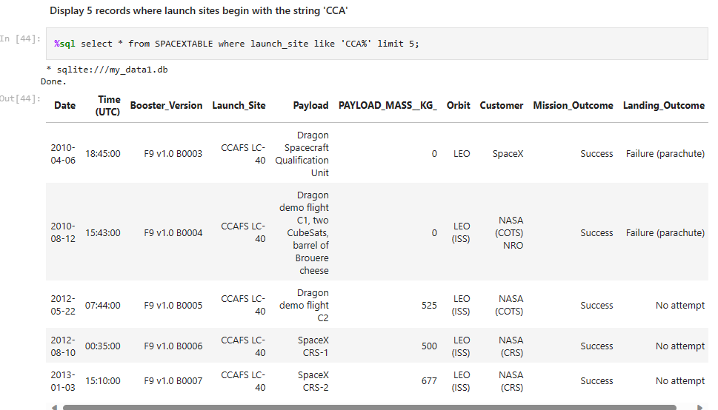
Launch Site Names Begin with 'CCA'
We used the below query to display 5 records where launch sites begin with the string ‘CCA’

Slide 26
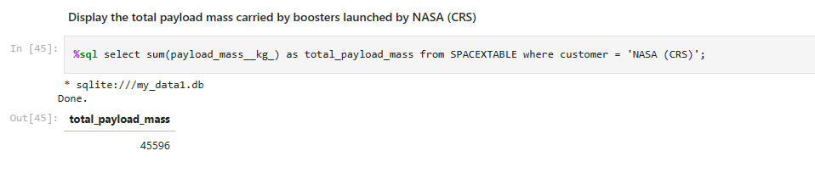
Total Payload Mass
We calculated the total payload carried by boosters from NASA as 45596 using the query below

Slide 27
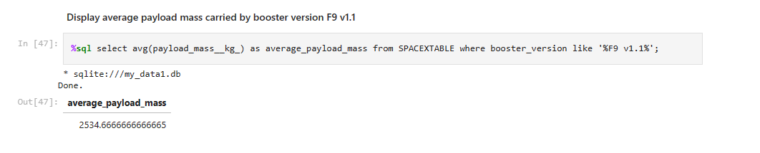
Average Payload Mass by F9 v1.1
We used the query below to calculate the average payload mass carried by booster version F9 v1.1 as 2534

Slide 28
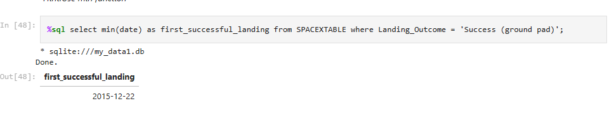
First Successful Ground Landing Date
We used the code below to calculate the dates of the first successful landing outcome on ground pad as December 22, 2015

Slide 29
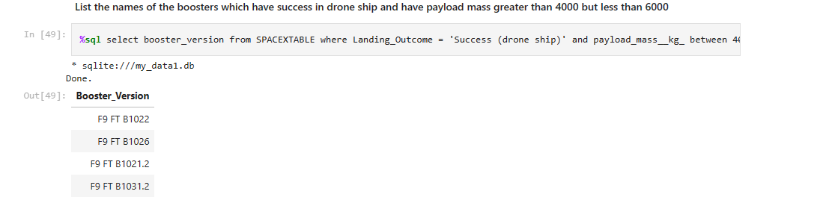
Successful Drone Ship Landing with Payload between 4000 and 6000
We used the WHERE clause filter for boosters which have successfully landed on drone ship and applied the AND condition to determine successful landing with payload mass greater than 4000 but less than 6000

Slide 30
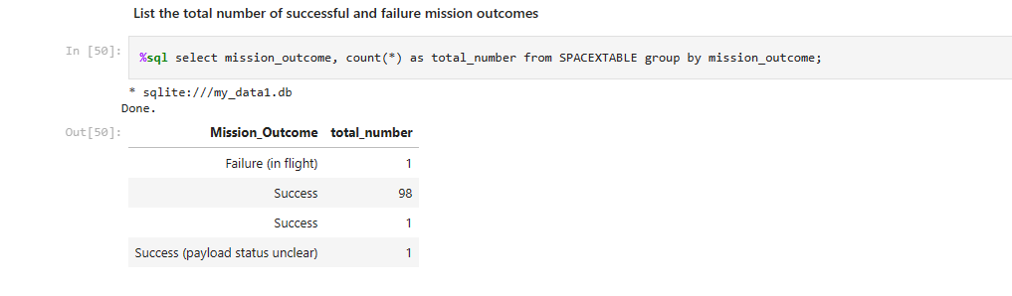
Total Number of Successful and Failure Mission Outcomes
We used the query below to calculate the total number of successful and failure mission outcomes

Slide 31
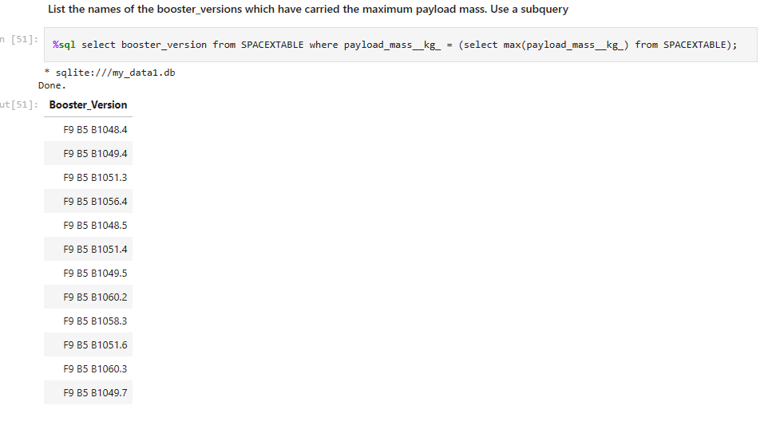
Boosters Carried Maximum Payload
We used the query below to determine the names of the booster which have carried the maximum payload mass

Slide 32
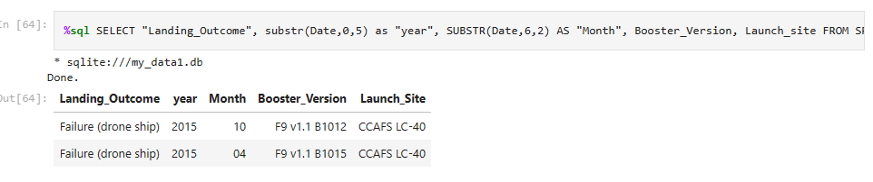
2015 Launch Records
We used the query below to determine the failed landing outcomes in drone ship, their booster versions, and launch site names in year 2015

Slide 33
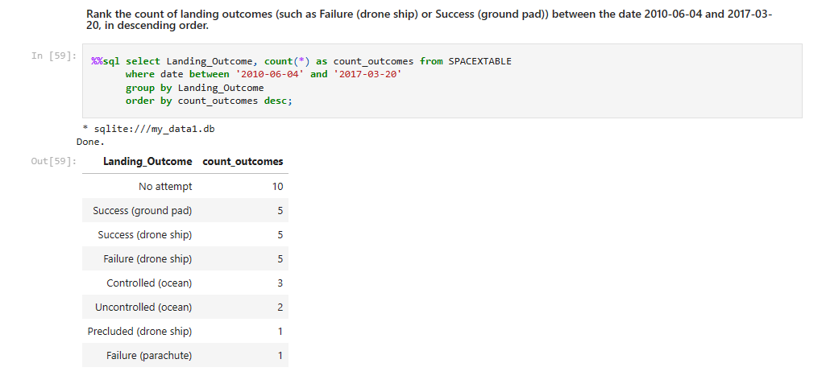
Rank Landing Outcomes Between 2010-06-04 and 2017-03-20
We selected the landing outcomes and used WHERE clause to filter the landing outcomes BETWEEN2010-06-04 and 2017-03-20. We the applied the GROUP BY clause to group the landing outcomes and ORDER BY clause to order the grouped landing outcome in descending order.

Slide 34

Section 3

Slide 35
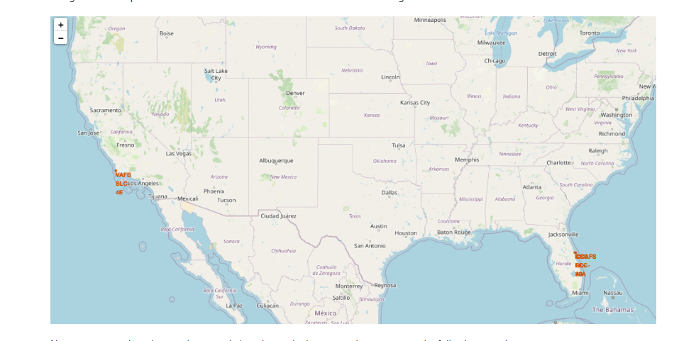
Launch Sites Global Map Markers
From the map below, it is evident that all launch sites are located within United States of American coasts, specifically California and Florida.

Slide 36
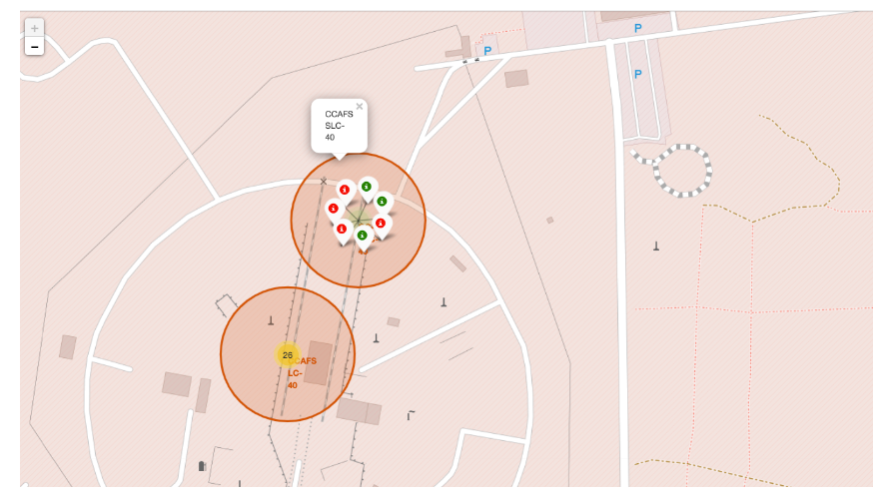
Markers Showing Launch sites with color labels
The green markers show successful launches while the red markers show failures

Slide 37
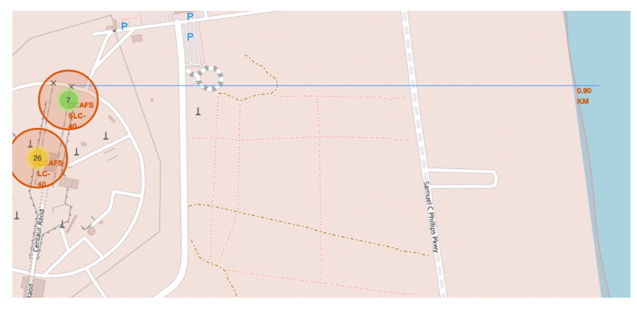
Launch Site Distance to Landmarks
From this map, it is evident that launch sites are in close proximity to coasts than highways and railways. This picture shows that the distance between launch site CCAFS SLC-40 to coastline is 0.90km.

Slide 38

Section 4

Slide 39

Pie Chart Showing Total Success Launches by Suites
Replace <Dashboard screenshot 1> title with an appropriate title

Slide 40

Launch Site with the Highest Success Rate

Slide 41
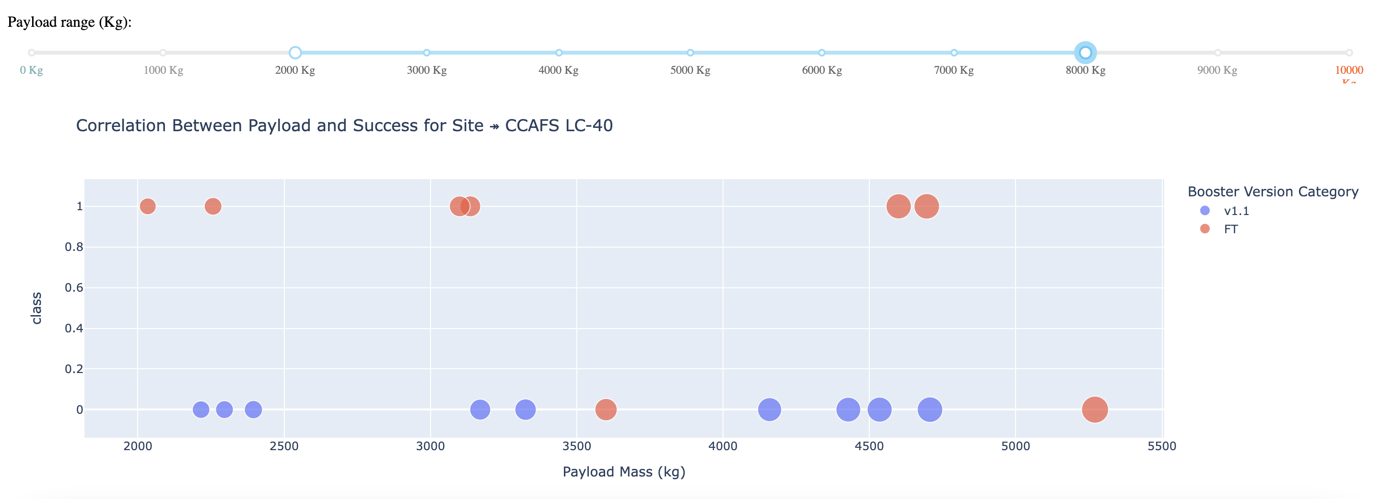
Correlation Between Pay Load and Success of All Sites

Slide 42

Section 5

Slide 43
Classification Accuracy
Model Accuracy: Decision Tree = 0.944
Model Accuracy: K-Neighbors = 0.833
Model Accuracy: Logistic Regression: 0.833
Model Accuracy: Support Vector: 0.833
The decision tree classifier is the model with the highest classification accuracy

Slide 44
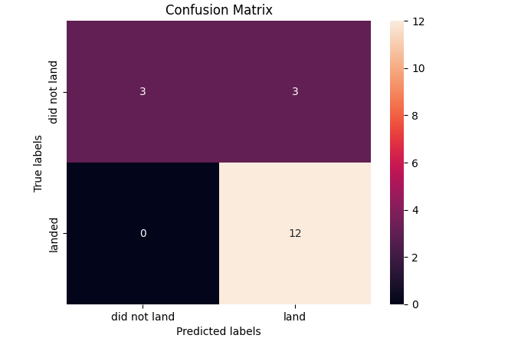
Confusion Matrix
The logistic regression has the best confusion matrix because it can distinguish between the different classes. The major problem is false positives.

Slide 45
Conclusions
Based on the results of this project, we can conclude that:
The greater the number of flights at a launch site, the greater the success rate.
Launch success rate was seen to increase from 2013 to 2020.
Orbits ES-L1, GEO, HEO, SSO, VLEO had the most success launch rates.
Of all the fours sites, KSC LC-39A seems to have had the most successful launches.
The Decision tree classifier emerged as the best machine learning algorithm for this project.

Slide 46
Appendix
Include any relevant assets like Python code snippets, SQL queries, charts, Notebook outputs, or data sets that you may have created during this project

Slide 47


